Slide 1
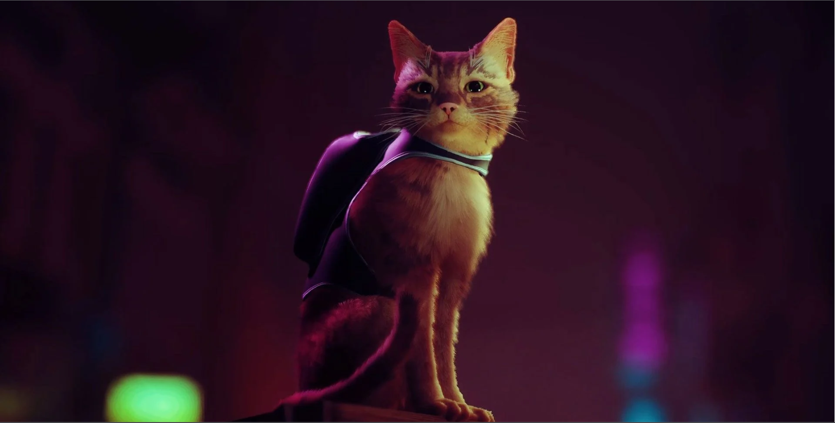
Feral

Slide 2
Game Story
Players are thrust into the world through the eyes of Luna, a feral cat living in the heart of New York City
On a mission to rescue recently kidnapped kittens
Simple plot, linear and easy to follow

Slide 3
Game Story Cont.
NOT intended to be a story driven experience
Basic plot points provide fundamental context of the world and the purpose of Luna’s adventure
Emphasis on complimenting the game mechanics through story elements

Slide 4
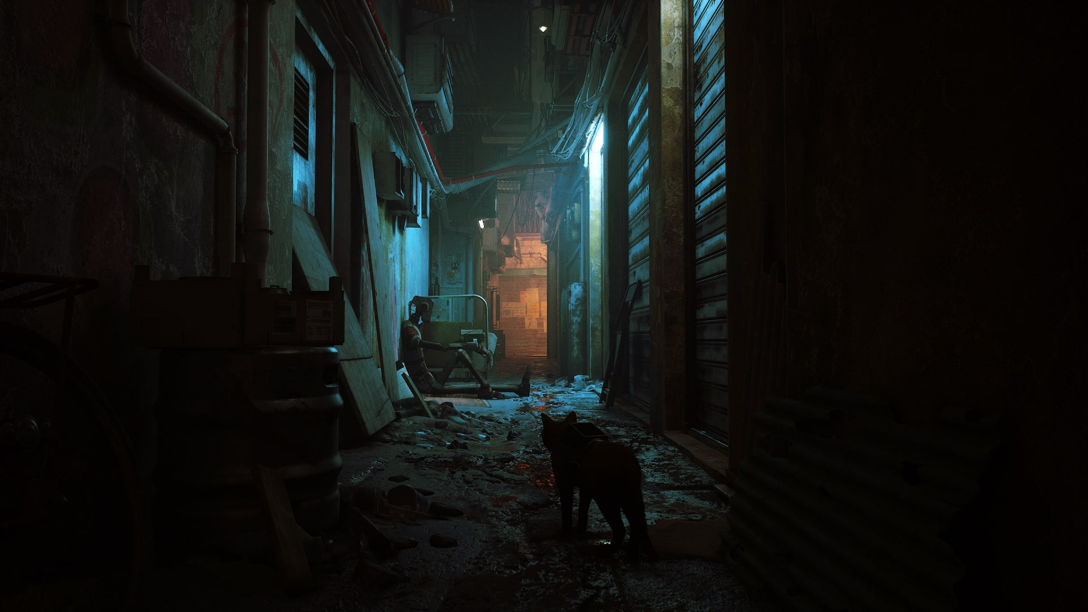
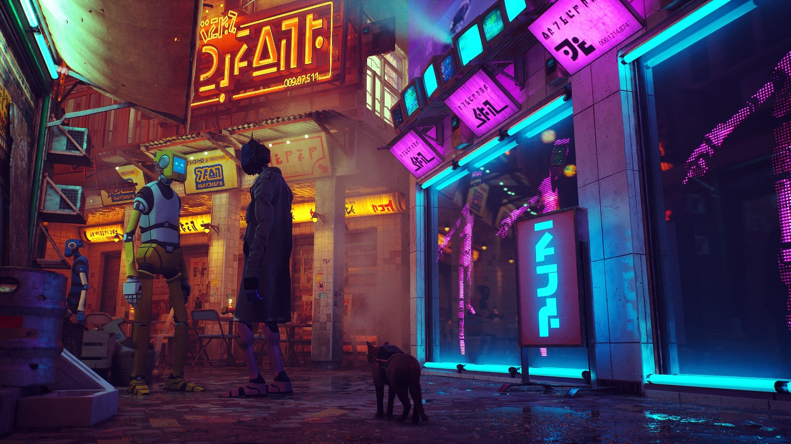
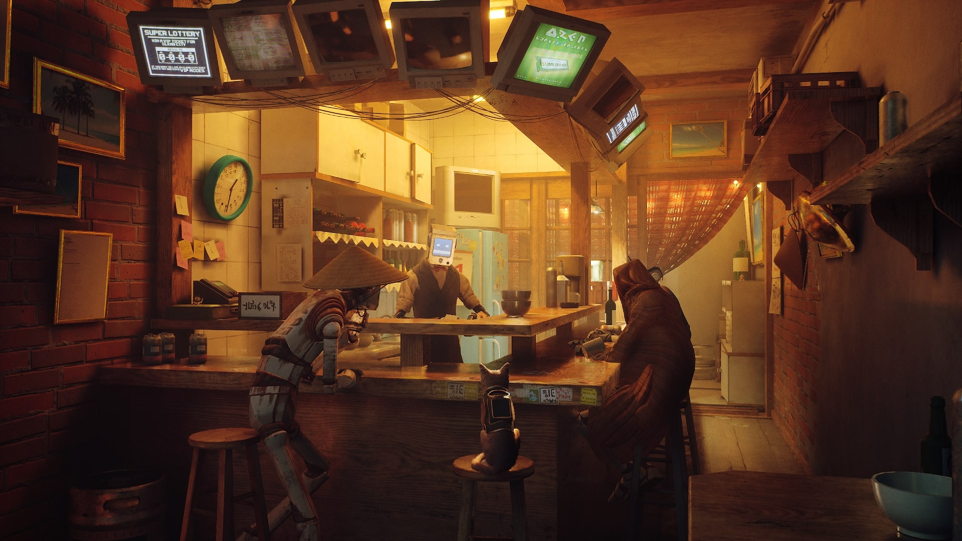
pics

Slide 5
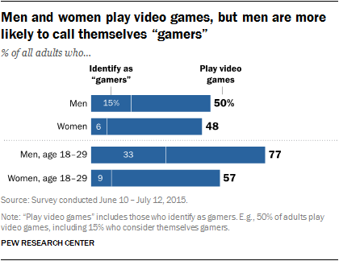
Target Audience
Casual Platformer Fan
Low barrier of entry
Broad subject matter appeal
Higher skill cap
Appeals to more experienced players
May limit accessibility
Via: https://www.pewresearch.org/internet/2015/12/15/who-plays-video-games-and-identifies-as-a-gamer/

Slide 6

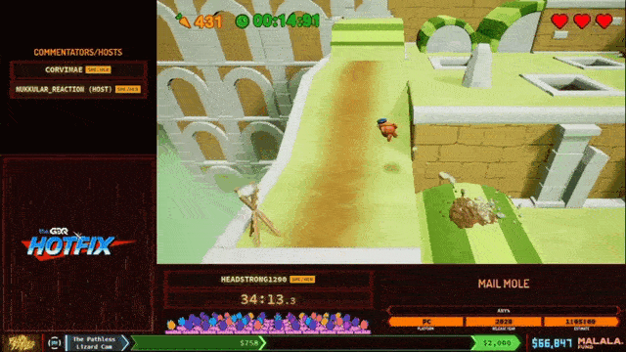
Target Audience Cont.
Speedrunners/Streaming Audience
Gameplay focused on momentum and flexible movement options
Immediately relatable world
High skill cap / Low barrier of entry
Footage via: https://www.youtube.com/watch?v=jeq11f7Ip3s

Slide 7






Monetary Strategy
One Time Purchase
Targeted Retail Price is approx. CDN$15
Comparable to other indie platformer games
* Prices via Steam as of January 2022
Expected Price Range

Slide 8
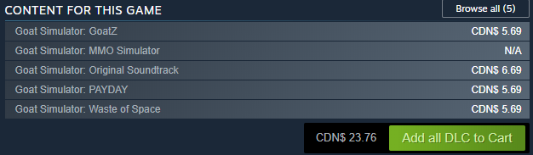
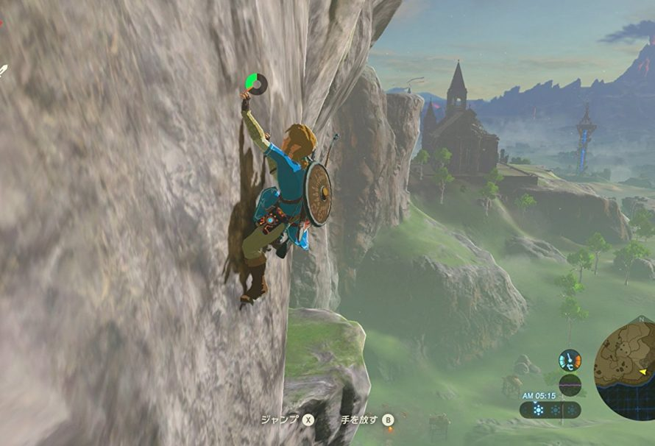
Additional Monetary Considerations
Two potential streams for generating further revenue:
Additional DLC Levels built on top of base game mechanics
Re-use of movement mechanics in a larger title to help offset development costs
Image via: https://www.justpushstart.com/2017/02/legend-zelda-breath-wild-season-pass-dlc-packs/

